Slide 1
Structures
2nd aggregate data type: struct
Recall: aggregate meaning “grouping”
Recall array: collection of values of same type
Structure: collection of values of different types
Treated as a single item, like arrays
Major difference: Must first “define” struct
Prior to declaring any variables

Slide 2
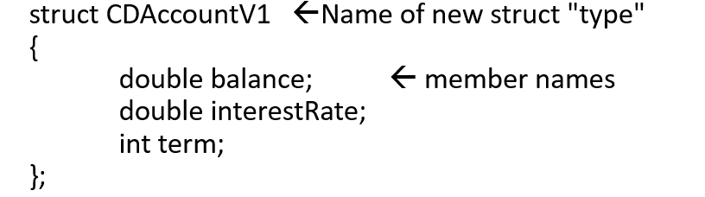
Structure Types
Define struct globally (typically)
No memory is allocated
Just a “placeholder” for what our struct will “look like”
Definition:

Slide 3
Declare Structure Variable
With structure type defined, now declare variables of this new type: CDAccountV1 account;
Just like declaring simple types
Variable account now of type CDAccountV1
It contains “member values”
Each of the struct “parts”

Slide 4
Accessing Structure Members
Dot Operator to access members
account.balance
account.interestRate
account.term
Called “member variables”
The “parts” of the structure variable
Different structs can have same name member variables
No conflicts

Slide 5
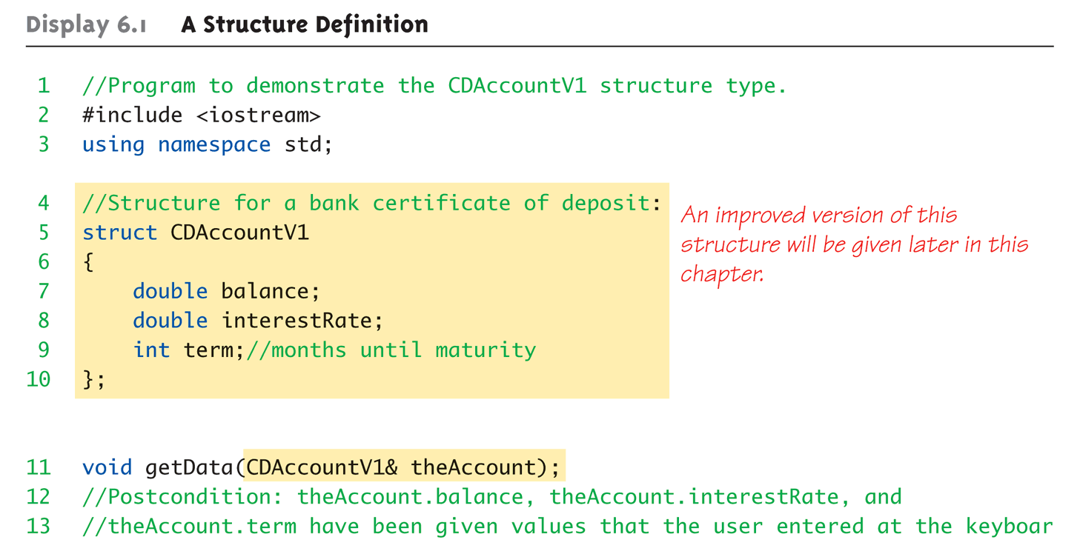
Structure Example: Display 6.1 A Structure Definition (1 of 3)

Slide 6
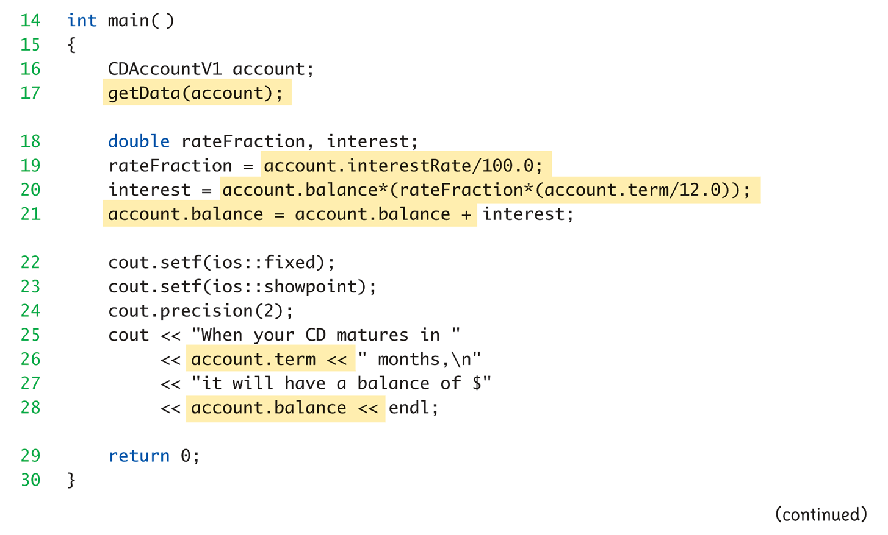
Structure Example: Display 6.1 A Structure Definition (2 of 3)

Slide 7
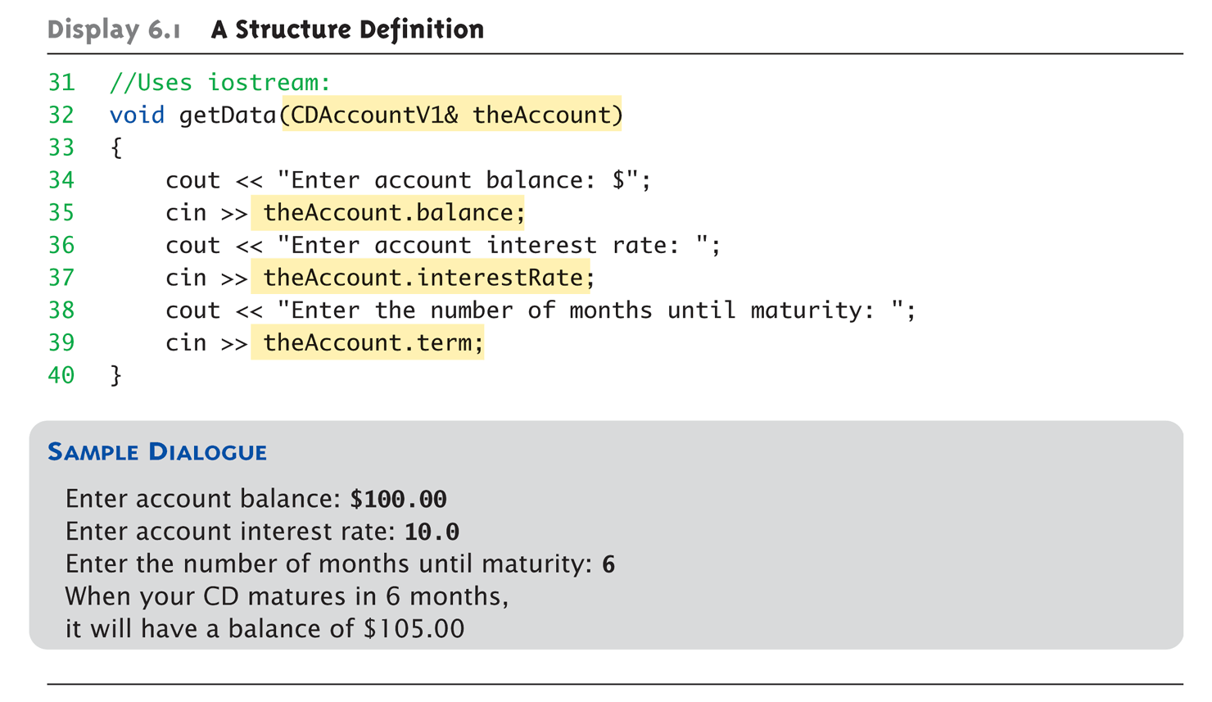
Structure Example: Display 6.1 A Structure Definition (3 of 3)

Slide 8
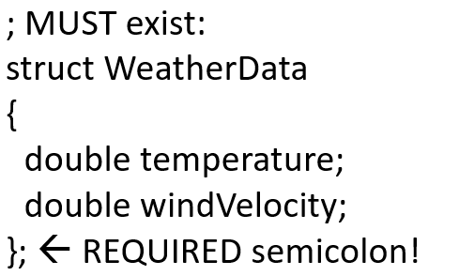
Structure Pitfall
Semicolon after structure definition
Required since you “can” declare structure variables in this location

Slide 9
Structure Assignments
Given structure named CropYield
Declare two structure variables: CropYield apples, oranges;
Both are variables of “struct type CropYield”
Simple assignments are legal: apples = oranges;
Simply copies each member variable from apples into member variables from oranges

Slide 10
Structures as Function Arguments
Passed like any simple data type
Pass-by-value
Pass-by-reference
Or combination
Can also be returned by function
Return-type is structure type
Return statement in function definition sends structure variable back to caller

Slide 11
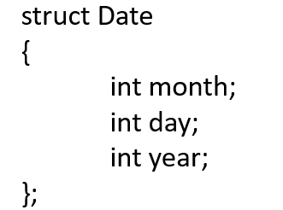
Initializing Structures
Can initialize at declaration
Example:
Date dueDate = {12, 31, 2003};
Declaration provides initial data to all three member variables

Slide 12
Classes
Similar to structures
Adds member FUNCTIONS
Not just member data
Integral to object-oriented programming
Focus on objects
Object: Contains data and operations
In C++, variables of class type are objects

Slide 13
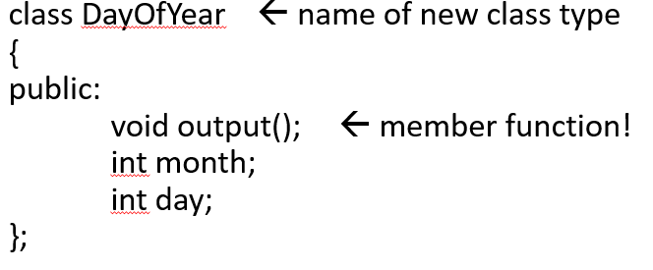
Class Definitions
Defined similar to structures
Example:
Notice only member function’s prototype
Function’s implementation is elsewhere

Slide 14
Declaring Objects
Declared same as all variables
Predefined types, structure types
Example: DayOfYear today, birthday;
Declares two objects of class type DayOfYear
Objects include:
Data
Members month, day
Operations (member functions)
output()

Slide 15
Class Member Access
Members accessed same as structures
Example: today.month today.day
And to access member function: today.output();→Invokes member function

Slide 16
Class Member Functions
Must define or “implement” class member functions
Like other function definitions
Can be after main() definition
Must specify class: void DayOfYear::output() {…}
:: is scope resolution operator
Instructs compiler “what class” member is from
Item before :: called type qualifier

Slide 17
Class Member Functions Definition
Notice output() member function’s definition (in next example)
Refers to member data of class
No qualifiers
Function used for all objects of the class
Will refer to “that object’s” data when invoked
Example: today.output();
Displays "today" object’s data

Slide 18
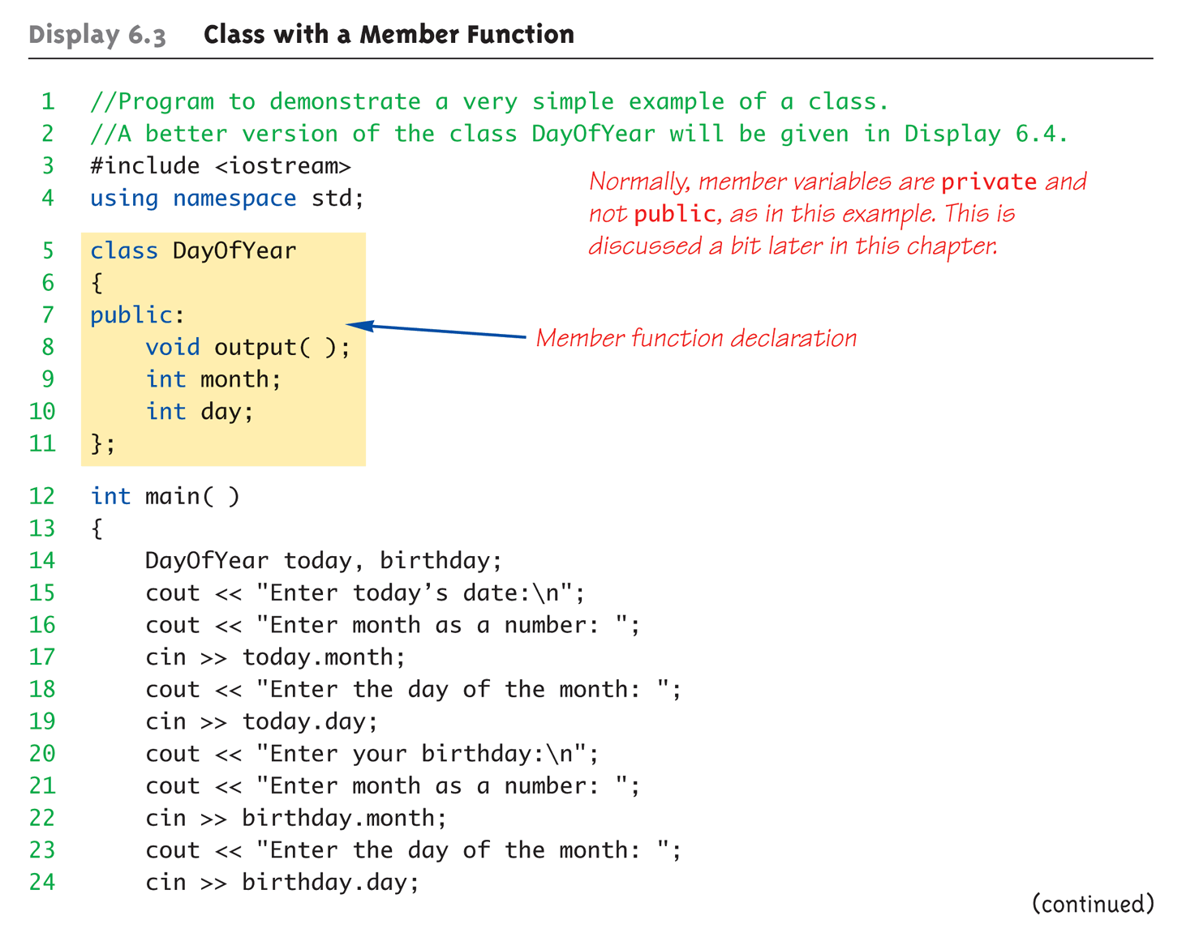
Complete Class Example: Display 6.3 Class With a Member Function (1 of 4)

Slide 19
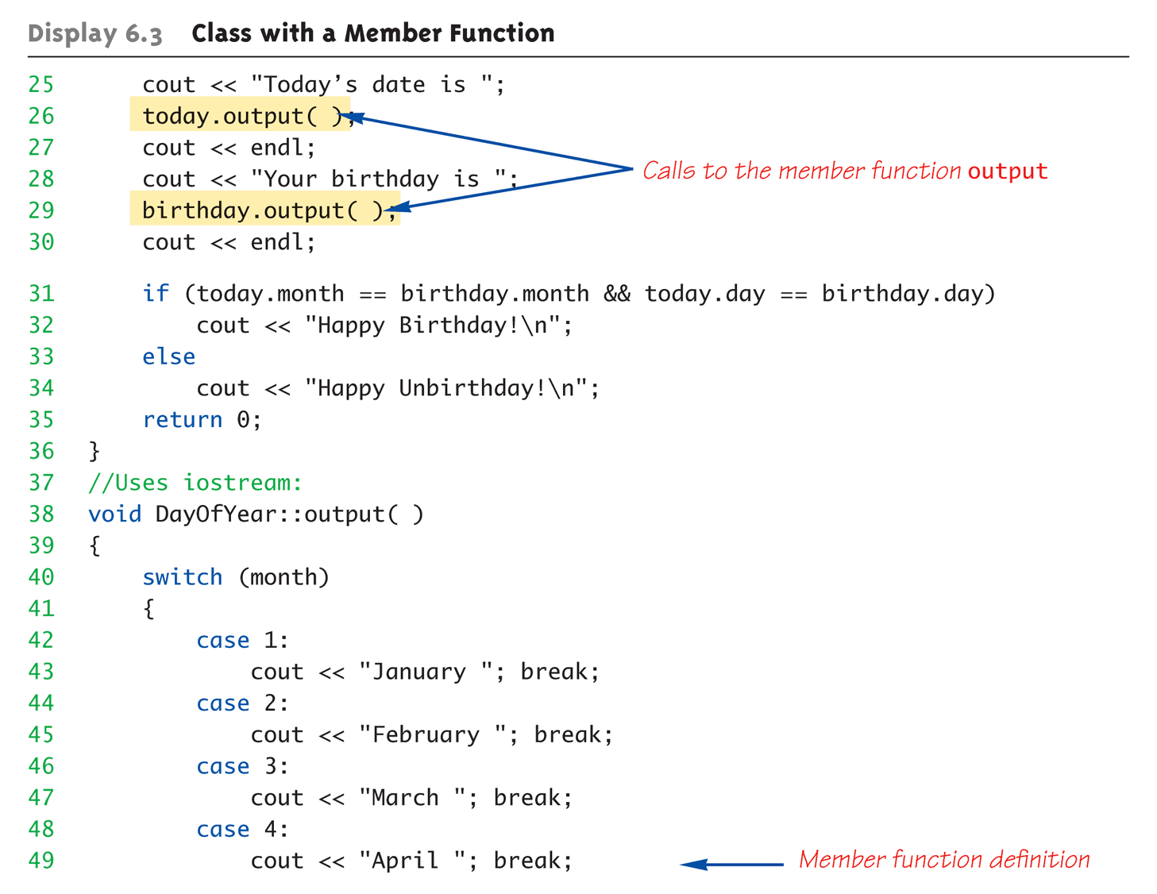
Complete Class Example: Display 6.3 Class With a Member Function (2 of 4)

Slide 20
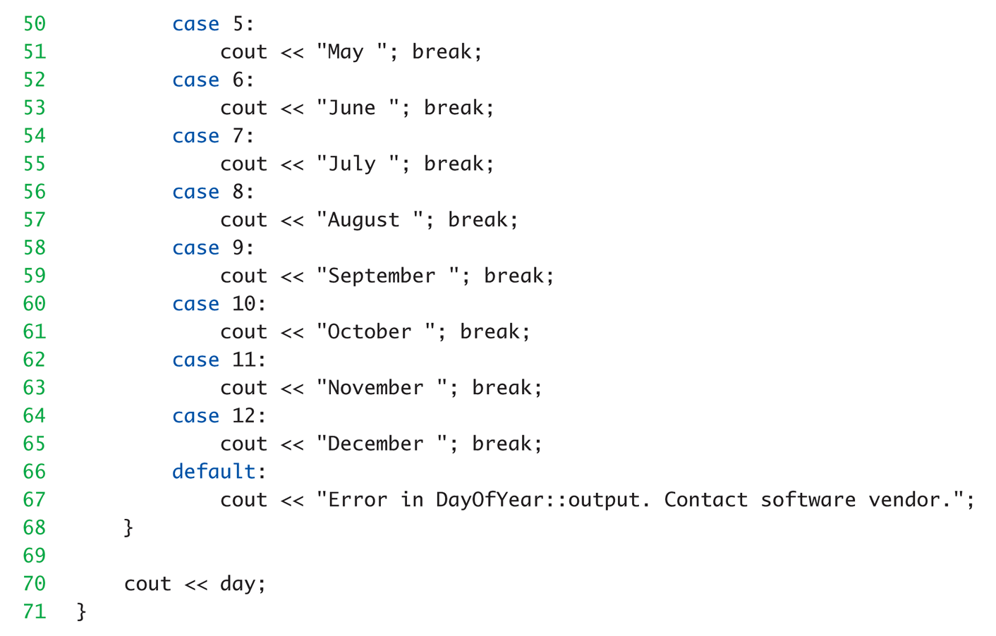
Complete Class Example: Display 6.3 Class With a Member Function (3 of 4)

Slide 21
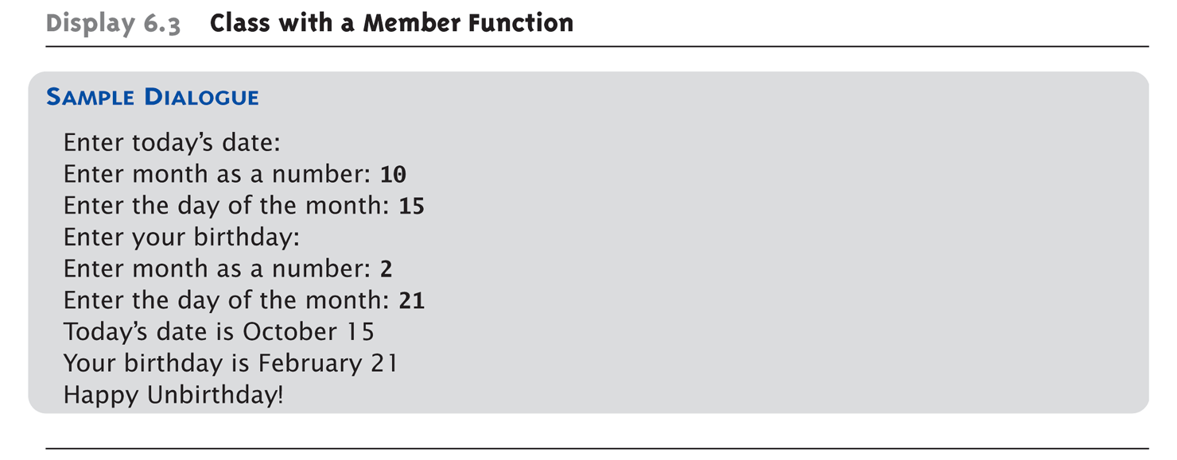
Complete Class Example: Display 6.3 Class With a Member Function (4 of 4)

Slide 22
Dot and Scope Resolution Operator
Used to specify “of what thing” they are members
Dot operator:
Specifies member of particular object
Scope resolution operator:
Specifies what class the function definition comes from

Slide 23
A Class’s Place
Class is full-fledged type!
Just like data types int, double, etc.
Can have variables of a class type
We simply call them “objects”
Can have parameters of a class type
Pass-by-value
Pass-by-reference
Can use class type like any other type!

Slide 24
Encapsulation
Any data type includes
Data (range of data)
Operations (that can be performed on data)
Example: int data type has: Data: -2147483648 to 2147483647 (for 32 bit int) Operations: +,-,*,/,%,logical,etc.
Same with classes
But WE specify data, and the operations to be allowed on our data!

Slide 25
Abstract Data Types
“Abstract”
Programmers don’t know details
Abbreviated “A D T”
Collection of data values together with set of basic operations defined for the values
A D T’s often “language-independent”
We implement A D T’s in C++ with classes
C++ class “defines” the A D T
Other languages implement A D T’s as well

Slide 26
More Encapsulation
Encapsulation
Means “bringing together as one”
Declare a class → get an object
Object is “encapsulation” of
Data values
Operations on the data (member functions)

Slide 27
Principles of O O P
Information Hiding
Details of how operations work not known to “user” of class
Data Abstraction
Details of how data is manipulated within A D T/class not known to user
Encapsulation
Bring together data and operations, but keep “details” hidden

Slide 28
Public and Private Members
Data in class almost always designated private in definition!
Upholds principles of O O P
Hide data from user
Allow manipulation only via operations
Which are member functions
Public items (usually member functions) are “user-accessible”

Slide 29
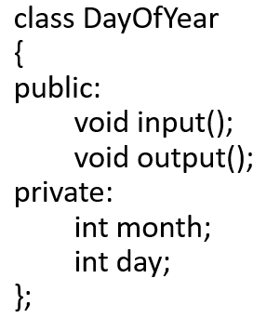
Public and Private Example (1 of 2)
Modify previous example:
Data now private
Objects have no direct access

Slide 30
Public and Private Example (2 of 2)
Given previous example
Declare object: DayOfYear today;
Object today can ONLY access public members
c in >> today.month; // NOT ALLOWED!
c out << today.day; // NOT ALLOWED!
Must instead call public operations:
today.input();
today.output();

Slide 31
Public and Private Style
Can mix & match public & private
More typically place public first
Allows easy viewing of portions that can be USED by programmers using the class
Private data is “hidden”, so irrelevant to users
Outside of class definition, cannot change (or even access) private data

Slide 32
Accessor and Mutator Functions
Object needs to “do something” with its data
Call accessor member functions
Allow object to read data
Also called “get member functions”
Simple retrieval of member data
Mutator member functions
Allow object to change data
Manipulated based on application

Slide 33
Separate Interface and Implementation
User of class need not see details of how class is implemented
Principle of O O P → encapsulation
User only needs “rules”
Called “interface” for the class
In C++ → public member functions and associated comments
Implementation of class hidden
Member function definitions elsewhere
User need not see them

Slide 34
Structures versus Classes
Structures
Typically all members public
No member functions
Classes
Typically all data members private
Interface member functions public
Technically, same
Perceptionally, very different mechanisms

Slide 35
Thinking Objects
Focus for programming changes
Before → algorithms center stage
O O P→ data is focus
Algorithms still exist
They simply focus on their data
Are “made” to “fit” the data
Designing software solution
Define variety of objects and how they interact

Slide 36
Summary 1
Structure is collection of different types
Class used to combine data and functions into single unit →object
Member variables and member functions
Can be public → accessed outside class
Can be private → accessed only in a member function’s definition
Class and structure types can be formal parameters to functions

Slide 37
Summary 2
C++ class definition
Should separate two key parts
Interface: what user needs
Implementation: details of how class works

